Slide 1
Event-Driven Programming and Postback
Chapter 3

Slide 2
What Are You Going To Learn?
At the end of this lesson, you will be able to:
Define event
Differentiate HTML events and Server Control events
Explain ASP.NET page events and PostBack
Apply event-driven programming

Slide 3
Event
An event is an action taken on your application by some force outside of your code.
This external force is usually the user, but could be another program.
An event can hold code that will run when the action occurs.

Slide 4
Event-driven Environment
Event-driven environment can be broken down into 4 chronological sections:
Section | Examples
An event occurs | The user clicks on a button (force from outside)
The system detects the event | ASP.NET registers that an event has occurred
The system reacts to the event | Some code is executed, e.g. calculation and display result
The system then returns to its original state | Waits for the next event

Slide 5
Event-driven Programming
The sequential way of code execution (line followed by line) is no longer necessary.
In event-driven programming, execution depends on user, i.e.:
system will wait until an event occurs

Slide 6
Events
3 major groups of events are supported by ASP.NET:
HTML events
ASP.NET page-level events
ASP.NET server control events

Slide 7
HTML Events
Occur on the Web page and are handled by the browser (client)
No transfer of information to the server.
Used to handle events on the client-side.
Example:
1) _____________________________________
2) _____________________________________
3) _____________________________________

Slide 8
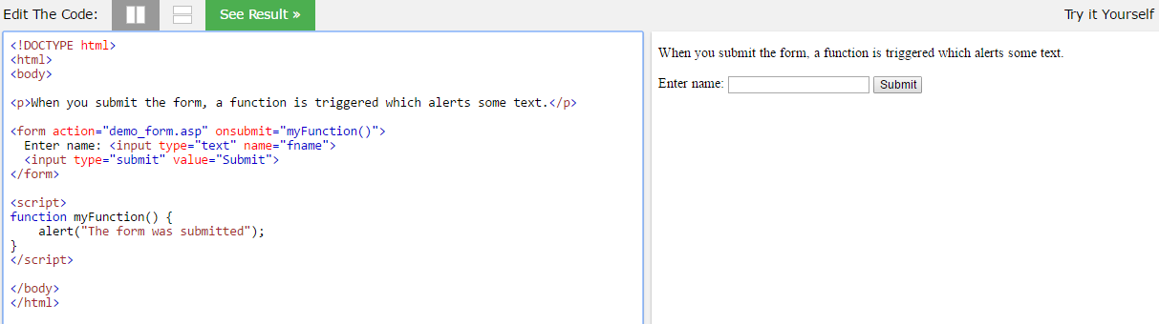
HTML Events

Slide 9
ASP.NET Events
ASP.NET Page Events
ASP.NET Server Control Events

Slide 10
ASP.NET Page Events
Events that are automatically run by ASP.NET when a page loads
They occur before the user can even sees the page.
No user involvement.
E.g. page load

Slide 11
Page Events and Stages
Initialization
PreInit
Init
InitComplete
Load
PreLoad
Load
LoadComplete
PreRendering
PreRender
PreRenderComplete
Render
Unload
Notes:
Init: Load the server controls default values
Load: Handle PostBack and Load _viewstate values
PreRender: To perform necessary updates before the output is rendered. Then generate a viewstate hidden field
Render: HTML writer object and uses it to accumulate all HTML text to be generated for the control.
Unload: to release any critical resource you might have (for example, files, graphical objects, database connections).

Slide 12
A series of events automatically occur on the Web server as follows:
Event | Occurs when ….
Init | A page is requested from the server. This event is raised before the view state of the page controls has been restored.
Load | A page is requested from the server, after all controls have been initialized and view state has been restored. This is the event you typically use to perform initialization operation such as retrieving data and initializing form controls.
PreRender | All the control events for the page have been processed but before the HTML that will be sent back to the browser is generated. (Not in your syllabus)
Unload | the page is unloaded from IIS memory and sent out to browser.
Notes:
Page_Init: It runs code before .NET displays controls on the page. It works in a very similar way to Page_Load(), but earlier.
Page_Load: occurs when the page has been read into memory and processed. But after some details about server controls have been initialized and displayed by Page_Init().
Page_Unload: The term unload is from the perspectives of servers, not the browser

Slide 13
ASP.NET Server Control Events
Largest events group
Handled by server
Occur due to user interaction with the page, i.e. it does not occur automatically like page event.
E.g. click event that associates with <asp:Button>

Slide 14
ASP.NET Server Control Events
ADVANTAGES:
All the event handler code executed on the server – more available resources like custom-built objects, etc.
Not relying on the browser’s capability to recognize and handle HTML events
Can use any language to write code for event handler

Slide 15
Recall
What are the 3 major groups of events supported by ASP.NET?
What are the 2 groups of events handled by server?
Why is it necessary to handle events on the client side since server-side event handlers are so powerful.
Notes:
We use client-side to perform simple tasks such as visual effects, input validations, calculations (e.g. currency conversion), etc. It provides immediate response since done locally.
Server-side programming technology is more powerful. Used to perform complex tasks such as form processing, security (login and logout), database access, etc but it has slower response since involve roundtrip (travelling of data between client and server).
Examples:
client-side event (either 1)
onmouseover – change the color of the button
onclick - pop-up confirmation dialog box, perform basic form validation, e.g. empty field
server-side events(either 1)
Button1_Click
Page_Load event

Slide 16
Adding Events to Server Controls
2 steps:
Add attribute with the name of the event and set its value to an event handler
e.g.
<asp:Button runat=“server” id=“button1” Text=“button” onclick=“Button1_Click” />
event
event handler name

Slide 17
Adding Events to Server Controls
2. Create the event handler – the function that runs when invoked by an event
protected void Button1_Click(object sender, EventArgs e)
{
// insert code to handle the click event
}
an event class that captures information regarding the state of the event being handled, and passes an object that’s specific to the event
provides a reference to the object (caller) that raised the event

Slide 18
Example of code - ImageClickEventArgs
<asp:ImageButton ID="ImageButton1" runat="server" ImageUrl="~/fish.jpg“ OnClick="ButtonClick" />
<asp:ImageButton ID="ImageButton2" runat="server" ImageUrl="~/cat.jpg" OnClick="ButtonClick" />
protected void ButtonClick(object sender, ImageClickEventArgs e)
{
if(sender.Equals(ImageButton1))
Label1.Text = "You clicked Button 1 at position (";
else
Label1.Text = "You clicked Button 2 at position (";
Label1.Text += e.X.ToString() + ", " + e.Y.ToString() + ")";
}

Slide 19
Differences between HTML Event and Server Control Event
HTML Event Handler | Server Control Event Handler
Runs on client side | Runs on server side
Rely on browser support | Works across all browsers since event is handled by server
Event handling code can only be written in Javascript | Event handling code can be written in any languages supported by .NET
Resources restricted to client side | More available resources

Slide 20
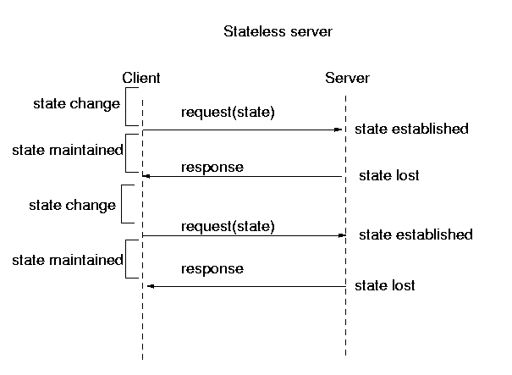


Stateless Request
HTTP is stateless - it retains no knowledge from one request to the next.
Request 1
client sending request
Request 2
Notes:
HTTP = HyperText Transfer Protocol. It does not retain the information for each request

Slide 21

Stateful Postback
server controls can retain their state across postbacks.
Postback - process by which the browser sends information to the server, which then handles the event, sending html back to the client.
Web forms must have runat="server" and only ASP.NET web controls can retain state.

Slide 22
Postback Process
1. Event occurs
ASP.NET Web
Controls info
Server
Client
2. Execute codes in event handler
3. Sends resulting HTML
back to client

Slide 23
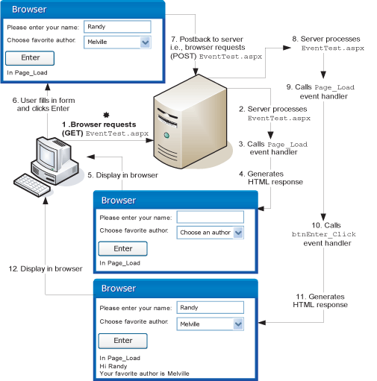

Slide 24
_VIEWSTATE
When Postback is used, information about the state of the ASP.NET form is sent back in an associated hidden control “_VIEWSTATE”, i.e.
<input type="hidden" name="__VIEWSTATE" value="dDwtNTMwNzcxMzI0Ozs+1ey3CbAun6n9axTH/QhVfpr1V/8=" />
encrypted value
Notes:
http://www.w3schools.com/aspnet/aspnet_viewstate.asp
http://www.c-sharpcorner.com/UploadFile/ee01e6/viewstate-for-textbox-in-Asp-Net/
Here's a list of controls that implement IPostBackDataHandler:
CheckBox
CheckBoxList
DropDownList
ListBox
RadioButtonList
TextBox

Slide 25
_VIEWSTATE
Information (value) in _VIEWSTATE is generated by ASP.NET by encrypting the values of the old state of the form (e.g. user selections for each Web control)
With this information, ASP.NET can persist the state between page submissions.

Slide 26
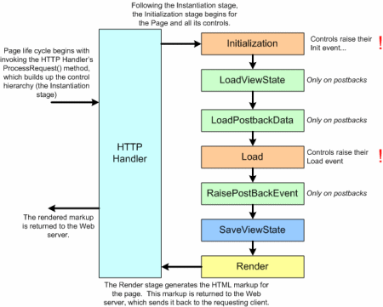
_VIEWSTATE

Slide 27
_VIEWSTATE
Stage 1 – Init page with default properties and values.
Stage 2 - Load View State and restore to controls
Stage 3 - Load postback data. Eg. Form data such as entered text. (NOTE: No viewstate involved here!)
Stage 4 - Page_Load event triggered.
Stage 5 - Raise postback event. Eg. Dropdownlist SelectedIndexChanged event, or button click event. Events can be data changed events or raised events. (NOTE: No viewstate involved here again!)
Stage 6 - Save view state
Stage 7 - Render

Slide 28
_VIEWSTATE
Q: So why need viewstate?
A: To store programmatic changes.

Slide 29
_VIEWSTATE
Consider the following aspx:
<asp:Label runat="server" ID="lblMessage"
Font-Name="Verdana" Text="Hello, World!"></asp:Label>
<br />
<asp:Button runat="server"
Text="Change Message" ID="btnSubmit"></asp:Button>
<br />
<asp:Button runat="server" Text="Empty Postback"> </asp:Button>

Slide 30
_VIEWSTATE
The code-behind class has the following event handler:
private void btnSubmit_Click(object sender, EventArgs e)
{
lblMessage.Text = "Goodbye, Everyone!";
}

Slide 31
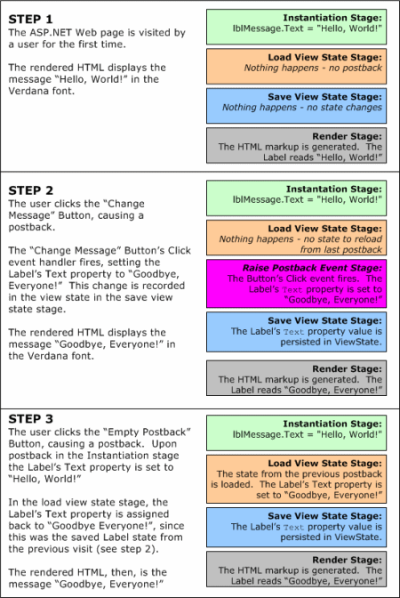
_VIEWSTATE

Slide 32
_VIEWSTATE

Slide 33
_VIEWSTATE
Can use ViewState property to persist page-specific and user-specific information across postbacks:
ViewState[keyName] = value
Usage scenario example: Creating a pageable, sortable DataGrid, since the sort expression must be persisted across postbacks.

Slide 34
Performance Cost of View State
Viewstate needs to be serialized into encoded string. Then, on postbacks, it needs to be deserialized, and update the controls.
Adds extra size to the Web page that the client must download.

Slide 35
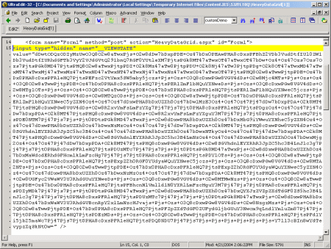
Performance Cost of View State
A DataGrid control’s ViewState grows huge quickly

Slide 36
Cross Page PostBacks
ASP.NET 2.0 and above includes the notation of a PostBackUrl property.
<asp:Button PostBackUrl=“url” ..>
used to get or set the URL of the page to post when the Button control is clicked.
the page is posted to the URL assigned, but not the page itself

Slide 37
Cross Page PostBacks
WebForm1.aspx
WebForm2.aspx
Button1.PostBackUrl = “WebForm2.aspx”;
TextBox t = PreviousPage.FindControl(“TextBox1”);
Label1.Text = t.Text;
PreviousPage property holds reference to the page that caused the postback (WebForm1).
FindControl method() - To get a control reference from the PreviousPage (you can also use the Controls property)

Slide 38
DEMO
Cross-Page PostBacks

Slide 39
Database programming
NEXT WEEK

